Slide 1
Unit 203: Electrical installations technology
Steel wire armoured cable (SWA)

Slide 2
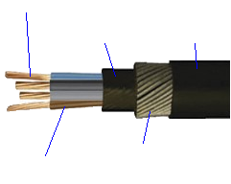
SWA
Conductor
PVC
bedding
sheath
PVC
serving
sheath
Steel
Wire
armour
PVC
insulation

Slide 3
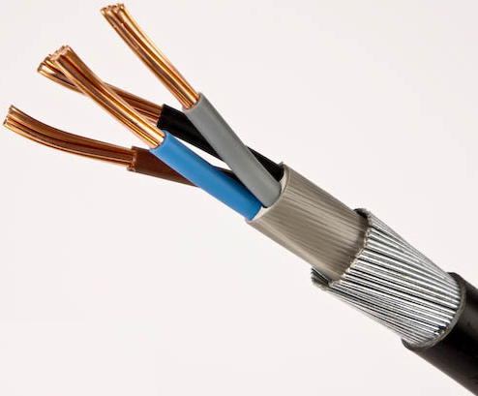
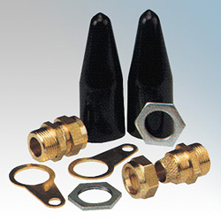
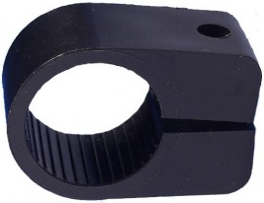
SWA

Slide 4
Unit 203: Electrical installations technology
The End

